Slide 1

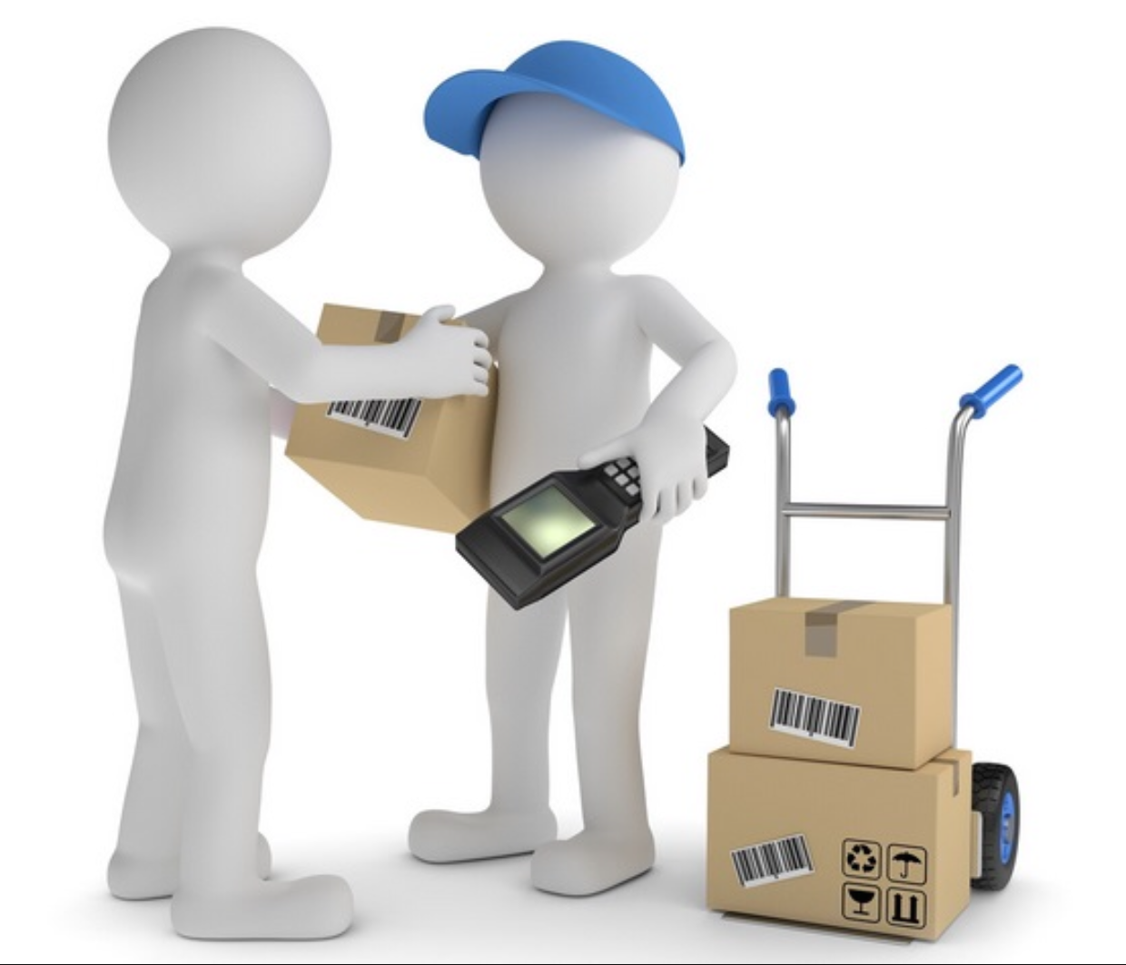
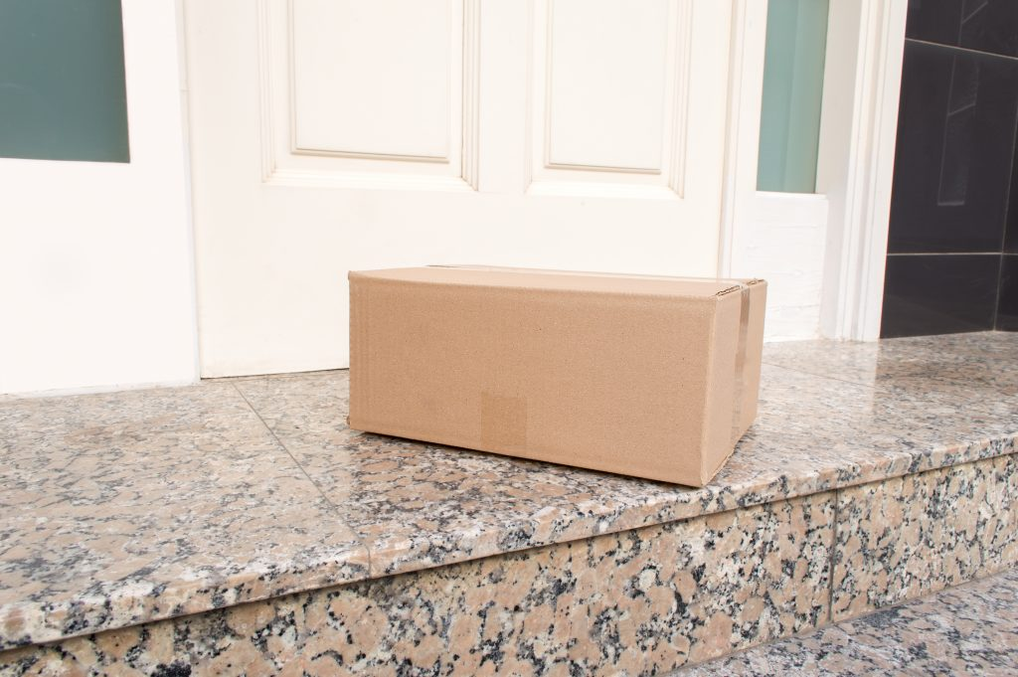
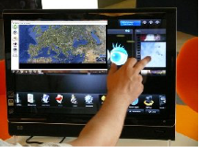
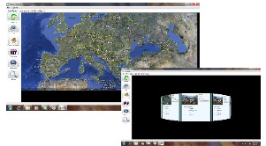

Real-TimeParcel Tracking
Problem
Opportunity
Solution
Resources
Now days thousands of parcels have been sent to all around world but at the same time the lost of parcels become a serious problem in modern industry. When the parcel lost we not only lose money but also time and resource. However if there is a method to track parcel easily it’s can avoid a lot of unnecessary cost.
Current solution is hard to know parcels exactly
position.
Postal service pay a lot to solve parcel lose.
Most of us has met some delivery problems.
Can built a effective logistic chin to enhance
the resource usage.
We develop a container consisting of a pressure
sensor and a GPS tracker that holds the package,
the container has a pressure sensing pad on top of
which the package is kept. The pressure sensor
senses whether the package is within the container
and sends the exact location of the package to the
user, whenever the user makes a request over
Internet/SMS. The device is provided supply
through a battery pack that can be charged
wirelessly. The entire system is controlled by the
postal services with the help of multiple
administrators.
The primary source of funding would be acquired from USPS. We would speaking to officials from USPS to come-up with a plan. The prototype can be built using everyday tracking devices.
.
Key point of our product
Clients can either buy our product or just rent it for specific duration.
It is very cost effective.
User will get constant alerts of the location of their parcel
Sensor to catch picture of whom so ever opens the box first for security.
Sensor for sensing internal temperature in box and Alert if the box is dropped.
Team Member Names, Majors, and Years in School
Wei Wang Computer Science 2016
Chinmay Mahajan Computer Science 2015
Pranay Ponnappa Somayanda Kariappa,
Computer Science, 2015

